Slide 1
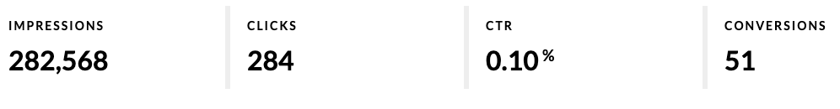

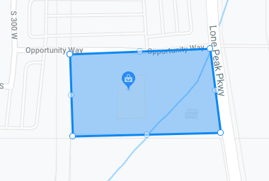
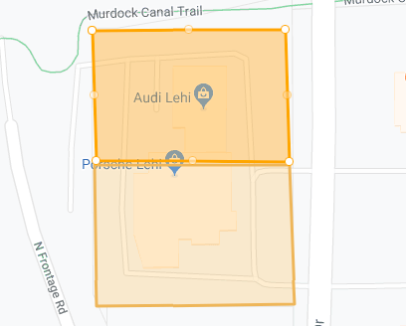

Case Study: Car Dealership
Campaign includes: Geo-Fencing with Conversion Sites.
Over
50 Onsite Visits from consumers who have seen the advertisement!
CAMPAIGN RESULTS:
Geo-Fence
Ad Type | Impressions | Clicks | CTR
Geo-Fencing | 282,568 | 284 | 0.10%
Customer is paying less than
$55 Per Onsite Conversions
as a result of this Campaign.
Conversion Zone

