Slide 1
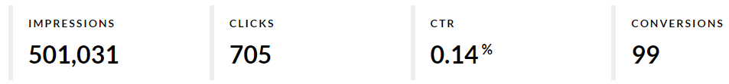
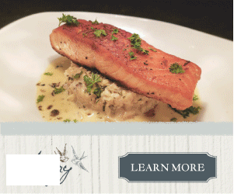
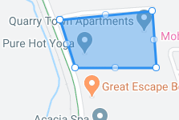
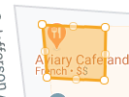
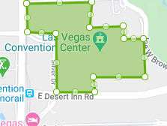

Case Study: Local Cafe
Campaign includes: Geo-Fencing with Conversion Zone and Event Targeting
CAMPAIGN RESULTS:
1.4x HIGHER
than the national average!
Ad Type | Impressions | Clicks | CTR
Geo-Fencing | 495,990 | 688 | 0.13%
Event Targeting | 5,041 | 17 | 0.34%
Customer is paying less than
$7.10 Per Click
as a result of this Campaign.
Geo-Fences
Conversion Zone
Event Targeting

